Slide 1
Revenue Assurance Prepaid Revenue Stream

Slide 2

Table of contents
 | Page
Fundamentals | 3
Prepaid Service Revenue Cycle | 7
How It Works? | 9
Risk Mitigation | 11
1
2
3
4

Slide 3
Fundamentals
1

Slide 4


Fundamentals
Prepaid v/s Postpaid
Definition
A
B
Prepaid Service:
Pay before using the service
Services are limited with respect to time and usage
Services expire once the validity lapses & recharge is required to use them again
Recommended for cost conscious users
Postpaid Service:
Pay your bill after use
No limit in using subscribed services unless credit limit enforced
Services need to be cancelled as non payment does not automatically cancel/bar the VAS
Recommended for heavy users
Prepaid mobile services are in which credit is purchased in advance. Purchased credit is used to pay for services at the point the service is accessed or consumed. If there is no available credit, access to the requested service is denied. Users are able to top up their credit by using a variety of payment mechanisms
Understanding Prepaid
1
2
3
The Plan
The Dough
Services
Contract specifies a limit of mins, data etc. which are paid for the by the subscriber in advance in form of recharge or packs
In Prepaid agreements, collection is made by the operator before the subscriber uses the service. This results in Positive Cash Position for the operator
Value Added Services like Live TV, Social Networking, Caller Tunes etc can be subscribed for on the prepaid connection
Notes:
Gaurav
Roaming OG call to other operators to other circle.

Slide 5
Terminologies- Prepaid (1/2)
A
B
C
Intelligent Network
Vouchers
Activation Process
It is an application that provides additional intelligence related to charging of services. Monitors usage & facilitates online charging of services for prepaid subscribers. Helps to develop & control services effectively
Amount being loaded into the SIM card, it allows the use of services. There are multiple sources for recharging like paper coupons, online, ATM, kiosk etc.
Prepaid SIMs are being pre activated at HLR with all the services provisioned with a barring component which gets removed at the time of activation
D
E
F
Talk Time
Validity Period
Life Cycle
Equivalent amount of money that can be utilized by prepaid subscribers for availing the mobile services on offer
Number of days for which a subscriber is allowed to avail the prepaid services, subject to condition that there is sufficient credit available to avail the service
Prepaid Subscribers follow a defined life cycle: HLR Loading->Active-> Grace -> Inactive -> De-activate -> Recycle
Notes:
Gaurav

Slide 6
Terminologies- Prepaid (2/2)
G
H
I
Usage
Recharges
Forfeiture
Prepaid subscribers balance is decremented in accordance with the usage of service and revenue is generated
Recharge sale is a form of advance to the operator. When subscriber utilized the balance earned on recharge, revenue is recognized against it
Balance which is taken out of subscribers account post expiry of grace period & booked as revenue
J
K
L
Main Account
Dedicated Account
Permanent Disconnection
It is a wallet in customers IN account where charging happens for all kind of transactions & decrement is booked as revenue
Accounts in IN through which customer charging will happen for specific call types.
Deletion of subscriber from all IT & network systems. Also known as Churn
Notes:
Gaurav

Slide 7
Prepaid Revenue Cycle
2

Slide 8


Prepaid Revenue Cycle: Recharges
Voucher Recharge:
Revenue Generation - Recharge
As discussed earlier, recharging allows replenishment of talk time balance for prepaid subscribers. Various kind of recharge vouchers are available in the market like:
Airtime Call Vouchers to increase the value of talk time for a subscriber.
Validity Vouchers to extend the validity period of the subscriber.
Vouchers for other services or promotional programs like free SMS pack etc
Recharge vouchers can be sold in physical voucher cards or electronic vouchers/ virtual recharge.
NOTE: Recharge sale is in form of an advance to the operator and when subscriber utilizes the balance earned on recharge, revenue is recognised against it.
When the subscriber uses a recharge voucher, the PIN is validated by the Voucher Management System (VOMS). Upon successful validation, IN updates the SDP to credit the recharge amount into subscriber’s account.
VOMS
IN
Subscriber
Electronic Recharge:
Internet
Subscriber
E-recharge vendor platform
IN
Notes:
Tariq

Slide 9

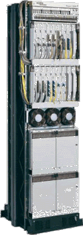
Prepaid Revenue Cycle: Usage
Revenue Generation – Usage
Let’s assume a prepaid subscriber A makes a call to another subscriber B.
A
Call from Subscriber A’s mobile station is routed to MSC vis BTS and BSC.
MSC verifies with the HLR to determine subscriber’s details.
HLR informs MSC about the prepaid status of the Subscriber A (Existence of prepaid flag in HLR indicates that the subscriber is a prepaid subscriber).
MSC then forwards the call to IN to determine if Subscriber A has sufficient balance to make the call.
BTS
BSC
MSC
HLR
MSC
IN
Lets recall here that IN is like a nucleus in this set up containing data pertaining to charging and services to be offered.
DISCONNECTED
BSC
B
BTS
IN confirms the available balance to the MSC:
Call is established in case of availability of sufficient balance,
Else it is disconnected by the MSC.
Notes:
Tariq

Slide 10
Prepaid Revenue Cycle: Usage
Revenue Generation – Usage (contd...)
Once the call is established, IN needs to start performing its function of real time rating and balance depletion.
A
B
IN starts granting time periods to MSC in buckets based on the defined time limit. For e.g., if defined time limit is 60 seconds, IN communicates with MSC every 60 seconds to either extend the call for next 60 seconds or disconnect the call.
Service will continue as long as IN keeps granting time to the subscriber. Call gets disconnected once IN stops granting time.
Subscriber is informed by SMS when the airtime balance is low or exhausted.
Once the call is complete, an INDR is generated in the IN. INDR contains call details like start time, end time, duration, amount/balance depleted etc.
BTS
BTS
DISCONNECTED
MSC
IN
Message to extends the call
Message to disconnect the call
Notes:
Tariq

Slide 11
How it works?
3

Slide 12
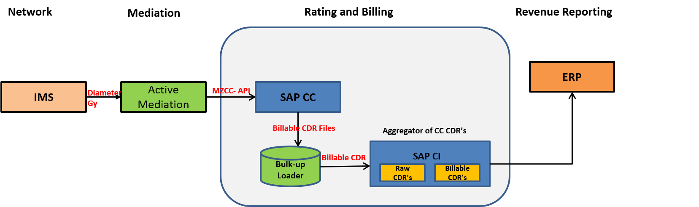
How it works
Prepaid Call flow
For LTE voice call IMS will send the charging information via RO interface to OCS. SAPCC is responsible for rating the CDRs on real time basis and the account is charged for the utilized service. SAPCC records/usage CDRs are used for revenue reporting and providing usage and rating information’s to customers
All the rated CDRs are grouped in files and pushed by SAPCC through a bulk up-loader to ERP. The bulk up-loader uploads the SAPCC CDRs to ERP as billable CDRs
These Billable CDRs are charged to the subscriber and the account is debited. The frequency of upload is user-based and currently the up-loader is uploading CDRs every one minute

Slide 13
Risk Mitigation
4

Slide 14
Risk Mitigation in Prepaid
Area | Risk | RA Control
Usage Reconciliation | Usage made not getting charged to the subscriber | Perform a check between MSC/IMS and IN usage CDR’s to check if all the usage CDR’s are getting captured in both the systems
Usage Reconciliation | Rating discrepancies between the rate applied in the usage CDR’s versus the marketing rate leading to revenue leakage or customer dissatisfaction in case of over-charging | Perform a periodic check between the rate applied on the usage CDR’s versus the marketing rate as per EPC to check if there are any discrepancies
Usage Reconciliation | Customer account not credited with correct recharge amount | Perform a check on the subscriber balance by summarizing subscriber usage and recharge and calculating the closing balance of the subscriber and check it against the actual closing balance
Usage Reconciliation | Subscriber account not getting depleted with the usage made | Perform a check on the subscriber balance by summarizing subscriber usage and recharge and calculating the closing balance of the subscriber and check it against the actual closing balance
Usage Reconciliation | Subscriber account not getting depleted with the usage made | Identify subscribers with negative balance in the subscriber dump
Notes:
Tariq

Slide 15
Thank You

